Slide 1
Lecture 6
Multi-Layer Networks
& Backpropagation

Slide 2
Multilayer Perceptrons
Single perceptrons can only learn linear decision boundaries, so these classes cannot be separated.
O
O
X
O
O
O
x₂
X
X
O
X
X
X
X
X
X
X
X
X
O
X
O
X
O
O
O
x₁

Slide 3
But two perceptrons can draw two linear decision boundaries to re-map the data to a new (p₁ , p₂) space
x₁
h₁
h₂
x₂
h₂
O
O
01
X
O
O
O
1
O
X
x₂
X
X
O
X
X
Perceptron h₁
X
X
X
11
X
Perceptron h₂
X
X
X
0
O
X
1
O
X
10
O
O
1
O
0
0
h₁
O
x₁
0
1
But how can the weights for the network be found?

Slide 4
…. and a third perceptron in the next layer can do the classification.
x₁
h₁
h₂
y
x₂
h₂
O
O
01
X
O
O
O
1
O
X
x₂
X
X
O
X
X
Perceptron h₁
X
X
X
11
1
X
0
Perceptron h₂
X
X
X
0
O
X
1
O
X
Perceptron y
10
O
O
1
O
0
0
h₁
O
x₁
0
1
But how can the weights for the network be found?

Slide 5
The Backpropagation Algorithm
Based on gradient descent.
Allows training of any feedforward network
Can be used to train recurrent networks
with minor modification.
- “Discovered” in various forms by:
Bryson and Ho 1969
Werbos 1974
Parker 1985
The familiar neural network formulation
by Rumelhart, Hinton & Williams, 1985
Why is backpropagation important?
Multilayer feedforward networks can
classify any data and approximate
any function
A general training algorithm for
such networks is very useful

Slide 6
The Backpropagation Algorithm
Output layer
(index i)
q = pattern index
n = # of inputs (input space dimension)
m = # of hidden neurons (hidden space dim.)
l = # of outputs (output space dimension)
w_{ij}= weight from hidden neuron j to
output i
w_{jk}= weight from input k to hidden neuron j
Hidden
Layer
(index j)
Input Layer
(index k)

Slide 7
Hidden Layer
Output Layer
Loss function

Slide 8
Hidden Layer
Output Layer
Loss function
This is easy to calculate using LMS
But how to calculate this?

Slide 9
Learning for the Output Layer
w₁₁
w₁₀
1
w₁₂
w₂₀
Output layer
(index i)
2
w_{1n}
w_{l0}
l
Hidden
Layer
(index j)
LMS
Input Layer
(index k)

Slide 10
1
2

Slide 11
Learning for the Hidden Layer
Note that
3
4

Slide 12
6
5

Slide 13
6
7
6
8
8
5
9
7

Slide 14
9
4
10
11

Slide 15
Gradient Calculation Process
1
same as LMS
10
same form as 1

Slide 16
Note how for hidden layer
is calculated recursively
1
1
2
l
10
-Signals flow forward
-Errors (δ’s) propagate backwards
can be calculated
at j if are known

Slide 17
Form of the Learning Rule
Compare and . Both have the form
2
11
A
B
where r indexes the neurons to which A connects.

Slide 18
M+1 Update Layer M
outputs
= network output
Layer M
1 Calculate Layer M δ’s
and M-1 M
M Update Layer M-1 outputs
Layer M-1
2 Calculate Layer M-1 δ’s
and M-2 M-1
3 Update Layer 2 outputs
Layer 2
M-1 Calculate Layer 1 δ’s
and 1 2
2 Update Layer 1 outputs
Layer 1
M Calculate Layer 1 δ’s
and inp 1
1 Apply input pattern
Input
M+1 Apply all
Multilayer BP Training

Slide 19
A General Formulation
Networks may use:
Different loss functions.
Different activation functions (even different between layers or within a layer.)
We can define a general formulation to handle this under the assumption that:
i.e., total loss is added over the output neurons.
For output layer weights:
Mean-squared loss function
Linear composition function

Slide 20
For the hidden layer weights:

Slide 21
For the hidden layer weights:
Mean-squared loss function
Linear composition function

Slide 22
Practical Choices

Slide 23
Using Backpropagation for Classification Problems
Backpropagation requires that exists
must exist
(activation function) must be differentiable
instead of hard threshold.
But classification requires that output
neurons have 0/1 or +1/-1 output
?????????

Slide 24
Possible Solutions
- Use 0/1 or +1/-1 as target values
- Set operating parameters H, L, L<H such that:
is considered a match for y_{i} = +1
is considered a match for y_{i} = 0 or -1
During training, use 0/1 or +1/-1 as targets but if matches the operating
targets, make no weight change
Typical values for H, L are:
H=0.75 L=0.25 for 0-1 sigmoid
H=0.75 L=-0.75 for +/- sigmoid

Slide 25
Multi-Class Classification
If there are more than 2 classes, how should the output be represented?
Solution:
If there are M classes, have M neurons in the output layer.
During training, use one-hot codes as targets for each class, e.g. if M = 3,
Class 1 = [1 0 0 ] Class 2 = [0 1 0] Class 3 = [0 0 1]
After training, for a test input x, choose the class as the output neuron with the highest output, e.g., Output = [0.1 0.6 0.2 ] → [0 1 0]
If “no choice” is allowed, require that an output must be higher than some threshold θ to be considered 1.
A better solution: softmax classifiers

Slide 26
Data Scaling
Given input vectors
Scale each x_{k} such that it is 0-mean and has approximately the same range as
the other components. Scaling between -1 and +1 is usually a good idea.
Note: if x_{k} > 0 in all cases
All weights for hidden neuron j either increase
together or decrease together
less discrimination in each training step
slower training

Slide 27
Data Scaling
In binary input situations, use +/- rather than 0/1:
Recall that inp hidden weights are modified as:
Using + allows an active weight change
at every steps rather than only at the
x = +1 steps.
0 inputs cause no weight change
even if is large
Learning on these inputs happens
only passively (by omission).
Potentially faster learning

Slide 28
Choice of Activation Function
Same reason as scaling inputs 0-mean
all weights to a target neuron
increase or decrease together
Le Cun (1989, 1993) suggests
a = 1.7159 b = 2/3
This gives f (1) = 1 f (-1) = -1
which allows greater discrimination
f (u)
In some cases, a rectified linear unit (ReLU)
may work well.
u

Slide 29
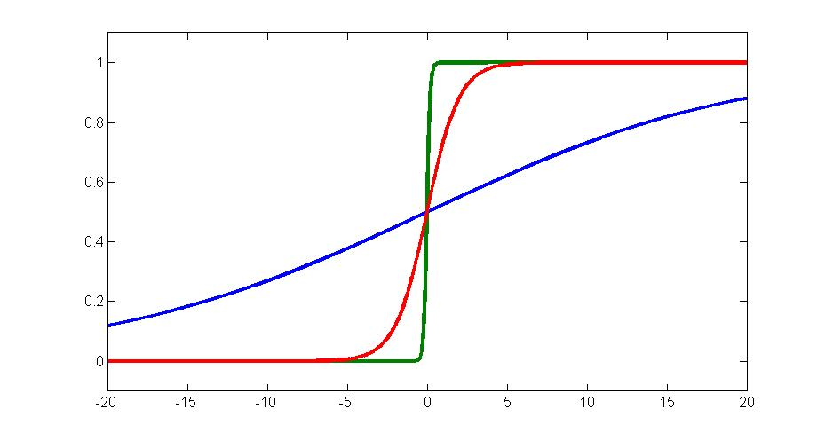
Weight Initialization
Consider
w=10
w=1
y
w=0.1
- If w is too small, is a small
value for most x → slow learning.
- If w is too large, wx is large for most x
(except near x = 0) and
(saturation) → slow learning.
x
- For , the same argument applies
w.r.t. values of ||w||
The more input lines a neuron has, the smaller its range of weights should be to avoid saturating the sigmoid and causing the gradient to vanish.

Slide 30
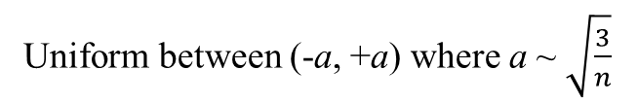
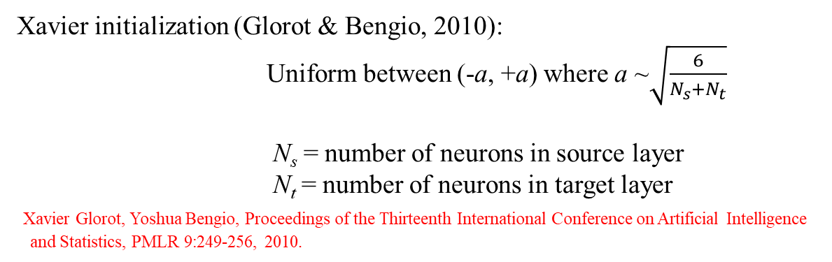
Gaussian with mean = 0, standard deviation σ ~ $\sqrt{\frac{2}{n}}$
Uniform between (-a, +a) where a ~ $\sqrt{\frac{3}{n}}$
Where n = number of inputs to the neuron.
Xavier initialization (Glorot & Bengio, 2010):
Uniform between (-a, +a) where a ~$\sqrt{\frac{6}{N_{s}+N_{t}}}$
N_{s} = number of neurons in source layer
N_{t} = number of neurons in target layer
Xavier Glorot, Yoshua Bengio, Proceedings of the Thirteenth International Conference on Artificial Intelligence
and Statistics, PMLR 9:249-256, 2010.
Don’t initialize all weights to identical values. This may cause all hidden neurons to learn the same thing and preclude overall learning.
Initialize weights to be both positive and negative instead of just positive.

Slide 31
Generalization and Validation

Slide 32
Fitting vs. Overfitting
(Classification)
Good Fit
Overfit
O
O
X
O
O
X
O
O
O
O
O
x₂
X
X
O
X
O
O
X
O
x₂
X
X
O
X
O
O
O
O
X
O
X
O
X
O
O
X
O
X
X
X
X
O
X
X
X
X
X
X
X
X
X
X
X
X
X
X
X
x₁
x₁

Slide 33
Fitting vs. Overfitting
(Approximation)
X
X
X
X
Linear Fit (fine)
Smooth nonlinear fit (best)
Overfit
X
X
X
X
X
X
X
x

Slide 34
Fitting vs. Overfitting
The fine variations seen in overfitting are fitting the “noise” rather than the “signal”
→ → poor generalization
What causes overfitting?
Too many “degrees of freedom” = ways of variation.
In feed-forward networks:
Degrees of freedom ↔ Number of weights and hidden neurons
More weights and neurons arrow more complicated functions and decision boundaries → Overfitting → Poor generalization
use fewer hidden neurons and/or fewer weights/neuron.

Slide 35
Regularization
Modifications to the learning process, network behavior, or network structure that force better generalization.
Some common regularization methods:
Early stopping.
Weight decay.
Pruning.
Dropout.
Sparsity constraints.

Slide 36
Early Stopping
- During training, periodically
evaluate network performance
on a validation set.
- If training and testing error are
both going down, keep training.
- If validation error starts to go up, stop
training even if training error is
still going down.
Training Error
Validation Error
Error
t
Assumes “Signal” is learned
before “noise”.
Once validation error starts
going up, it will never
reverse course
Stop here
1
2
Both are heuristics

Slide 37
Weight Decay
Force the total weight of the network to be as low as possible.
For example, add a weight penalty term to the loss function:
Weight Penalty
Why does this work?
It forces the network to use weights more efficiently in one or both of two ways:
Make all weights small → smoother function
Use fewer non-zero weights → fewer degrees-of-freedom
Both → better generalization.

Slide 38
Pruning and Construction
Pruning:
- During training, encourage the network to use as few weights as possible
→ some weights become ≈ 0
- Remove weights of very small size
Notes: Some algorithms do only the second step
Pruning algorithms can also remove
neurons to become useless
1
2
Construction:
Type I: Start with a small network, train as far as possible, add a neuron
and keep training. Repeat this process till satisfied.
Type II: Start with a large network, train, prune, train, add, ….

Slide 39
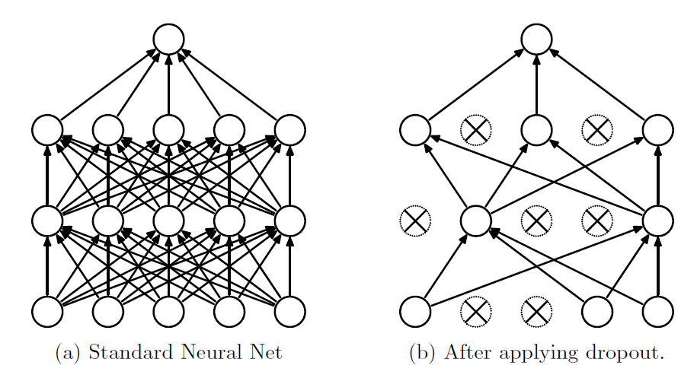
Dropout
(Srivastava et al., 2014)
Randomly leave out some inputs and hidden neurons during each iteration of the learning update, to prevent them from co-adapting – forcing them to learn somewhat different “views” of the data.
Srivastava et al. (2014) Dropout: A Simple Way to Prevent Neural Networks from Overfitting,
Journal of Machine Learning Research 15: 1929-1958

